Slide 1
Continuous Integration / Continuous Delivery & Infrastructure as Code
Amanda Tan and Nicholas Moore
7th September 2020

Slide 2

Continuous Integration / Continuous Delivery & Infrastructure as Code
Today’s Discussion
CI/CD Overview
IaC Overview
Walkthrough: ARM Template
Azure DevOps Pipelines
Demo: IaC Deployment Across Enviroments

Slide 3
CI/CD Overview

Slide 4
Why do CI/CD

Slide 5
Before CD: Manual Deployment & Large Deployment
Manual Deployments
Higher risk
Take a lot longer
Off-Business Hours
Manual steps document
Test the documented steps manually
Performed by designated operation team
Larger number of changes per deployment
Large Deployments
Take longer to execute
A lot expensive process
Harder to rollback if failed
Miss out on market opportunities
Significant higher deployment pain
Bigger testing scope after deployment
Larger feedback takes longer to implement
!
Notes:
References:
https://martinfowler.com/bliki/ContinuousDelivery.html

Slide 6
After CD: Continuous Delivery
Less waste
Faster ROI
Lower Risk
Higher quality
Early feedback
Better Planning
Faster collaboration
Everyone is involved
Less production Issues
Adapt and react a lot quickly
Much more predictable releases
Deploy during any business hours
Faster response to the market changes
Change delivered without significant delay
Anyone in the team can initiate deployments
Fast, repeatable and configurable deployments
Build & Test
Deploy
Continuous delivery
Develop
Operate
Plan & Track
Monitor & Learn
Notes:
Faster ROI
Lower Risk
Less waste
Higher Quality
Early feedback
Better Planning
Faster collaboration
Everyone is involved
Less Production Issues
Adapt and react quickly
More predictable releases
Deploy during business hours
Faster Response to market changes
Anyone in the team can initiate deployments
Changes delivered without significant delays
Fast, repeatable & configurable deployments

Slide 7
What is CI/CD

Slide 8

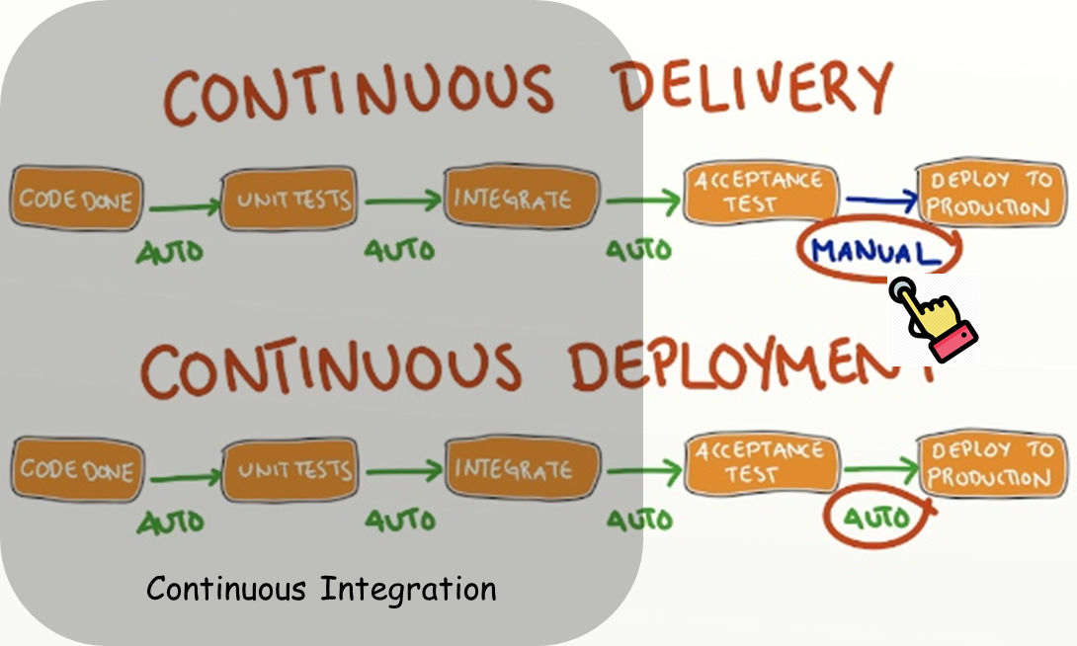
What is Continuous Integration
Continuous Integration
is a Mindset and a Team Strategy
“… a software development practice where members of a team integrate their work frequently, usually each person integrates at least daily - leading to multiple integrations per day. Each integration is verified by an automated build (including test) to detect integration errors as quickly as possible. Many teams find that this approach leads to significantly reduced integration problems and allows a team to develop cohesive software more rapidly.”
Source: https://martinfowler.com/articles/continuousIntegration.html
Notes:
Continuous Integration
is a Mindset and a Team Strategy
“… a software development practice where members of a team integrate their work frequently, usually each person integrates at least daily - leading to multiple integrations per day. Each integration is verified by an automated build (including test) to detect integration errors as quickly as possible. Many teams find that this approach leads to significantly reduced integration problems and allows a team to develop cohesive software more rapidly.”

Slide 9
What are the Goals of Continuous Integration
CI Goals:
#1: Harness collaboration
#2: Enable parallel development
#3: Minimize integration debt
#4: Act as a quality gate
#5: Automate Everything!
The main purpose of Continuous Integration is to prevent developers stepping over each other code and eliminate integration issues.
Notes:
Is a Team of developers working together on the same code base.
Each developer needs to:
Locally Develop new features using the latest code.
Build and Test code locally
Merge those changes into a shared source code repository linking associated task.
Have code changes reviewed
Code gets Built and validated in a standard process
Ultimately the code gets delivered to prod

Slide 10
Elements of Continuous Integration
Version Control System
Application / Test Code
Configuration
Database Definition
Seed / Test Data
Build / Deployment Scripts
Branching Strategy
Have a Branching strategy
Keep changes small
Commit frequently
At least once per day for each developer
Automated Build
Runs after every commit/check-in
Checks quality of the commit (Shift Left Testing)
Separate Build machine (Build Server)
Must run fast
Agreement of the Team
Continuous integration is a practice, not a tool. It requires a degree of commitment and discipline from your development team.
Notes:
Source: https://learning.oreilly.com/library/view/continuous-delivery-reliable/9780321670250/ch03.html
Agreement of the Team
Continuous integration is a practice, not a tool. It requires a degree of commitment and discipline from your development team. You need everyone to check in small incremental changes frequently to mainline and agree that the highest priority task on the project is to fix any change that breaks the application. If people don’t adopt the discipline necessary for it to work, your attempts at continuous integration will not lead to the improvement in quality that you hope for.
Build Server. Clean, rebuildable at any time. Developer machine may have conflicting configuration
Keep changes small. The bigger the change the more (and longer) the developers have to troubleshoot and he more code they have to re-remember and walk through to resolve issues (the code is less fresh in their heads)

Slide 11
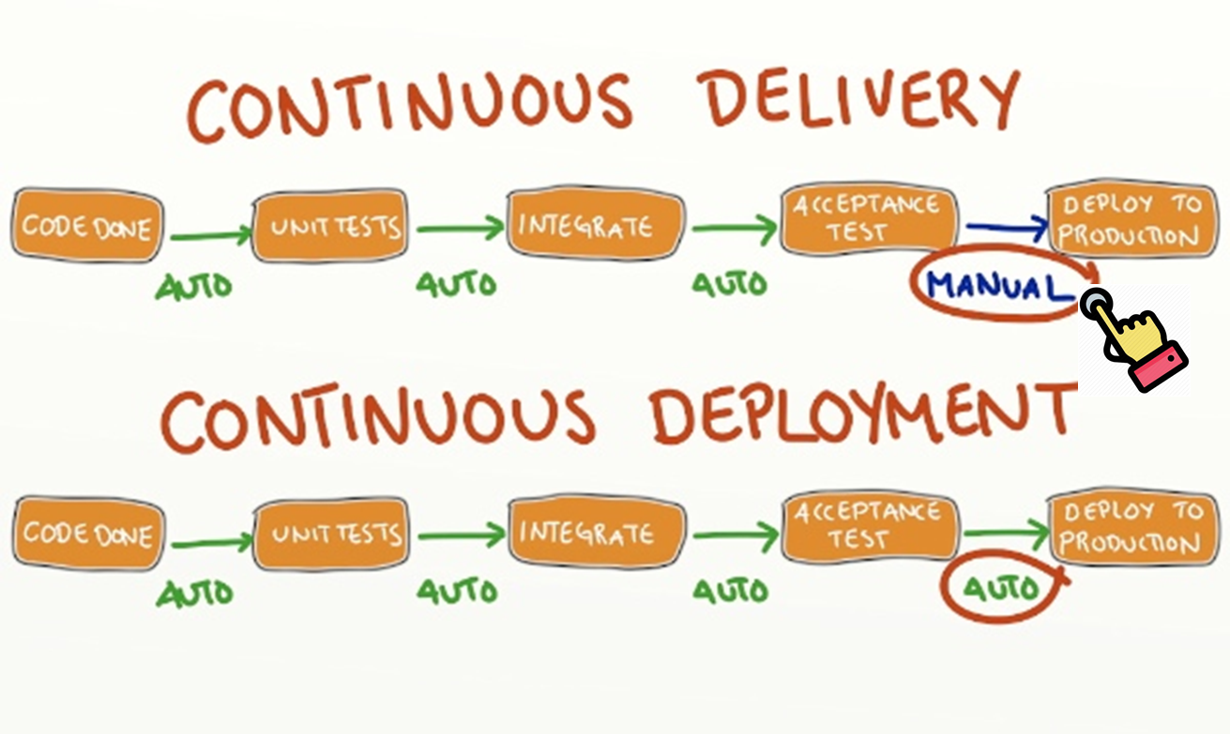
What is Continuous Delivery
Continuous delivery is a software engineering approach in which teams produce software in short cycles, ensuring that the software can be reliably released at any time and, when releasing the software, doing so manually. It aims at building, testing, and releasing software with greater speed and frequency. The approach helps reduce the cost, time, and risk of delivering changes by allowing for more incremental updates to applications in production. A straightforward and repeatable deployment process is important for continuous delivery.
Source: https://en.wikipedia.org/wiki/Continuous_delivery
Notes:
Continuous delivery (CD or CDE) is a software engineering approach in which teams produce software in short cycles, ensuring that the software can be reliably released at any time and, when releasing the software, doing so manually.^{[1][2]} It aims at building, testing, and releasing software with greater speed and frequency. The approach helps reduce the cost, time, and risk of delivering changes by allowing for more incremental updates to applications in production. A straightforward and repeatable deployment process is important for continuous delivery.
Source: https://martinfowler.com/bliki/ContinuousDelivery.html
Source: https://en.wikipedia.org/wiki/Continuous_delivery
Source: https://en.wikipedia.org/wiki/Continuous_deployment

Slide 12

Performance with and without CD
2017 | High Performers | Medium Performers | Low Performers
Deployment Frequency | Multiple per day | 1 week – 1 month | 1 week – 1 month
Lead Time For Changes | <1 hour | 1 week – 1 month | 1 week – 1 month
MTTR | <1 hour | <1 day | 1 day – 1 week
Change Failure Rate | 0-15% | 0-15% | 31-45%
Software Delivery
Performance
Notes:
Please note for low performers, as the speed increases, the quality decreases.

Slide 13

High Performers and Traditional Enterprise
Company | Deploy Frequency | Lead Time | Reliability | Customer Responsiveness
Amazon | 23,000/ day | Minutes | High | High
Google | 5,500/ day | Minutes | High | High
Netflix | 500/ day | Minutes | High | High
Facebook | 1/ day | Hours | High | High
Twitter | 3/ week | Hours | High | High
Traditional Enterprise | 1/ 9 months | Months or Quarters | Low/ Med | Low/ Med
Software Delivery
Performance
Notes:
From The Phoenix Project:
High Performing DevOps Organizations will outperform their non-high-performing peers
In agility metrics:
30x more frequent deployments
8,000x faster code deployment lead time
In reliability metrics:
2x the change success rate
12x faster MTTR
* Customer Responsiveness = Customer Satisfaction

Slide 14
How to do CI/CD

Slide 15



Continuous Integration Practices
Multi-Repo
Culture & Collaboration
Trunk Based Branching
Continuous Integration
Unit Testing
Branch Policies
Pull Requests
Parallel Builds
Security Scanning
Notes:
This list shows 8 practices we discussed in this deck, please review the list, we will practice all 8 in the CI labs.

Slide 16

Build Quality In by Testing Early in the Cycle
Common Activities:
Coding Standards Checking
Download Dependent Packages
Build Code
Unit Testing
Code Coverage Analysis
Cred Scan
Static Code Analysis
Open Source Component Scan
In Memory Code Validation
Create Deployable Package
Image Source: https://flatbike.com/quality-check/
Notes:
Since CI is part of CD, we should strive to do as much quality test as possible in CI stage.

Slide 17








Continuous Delivery Practices
Automated Builds
Everything in Source Control
Build Once
Feature Flags
Continuous Delivery
Trunk Always Prod Ready
Blue/Green Deploy
Fix Immediately
Canary Deployment

Slide 18
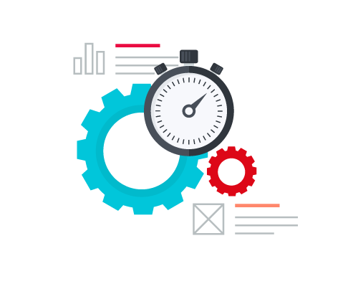
Automated Deployments
Deployments are scripted or automated via an Automated Deployment tool.
Automated Deployments are configurable, repeatable and reliable
Deployment automation artifacts are stored and maintained in the source control system
Use the exact same process for all deployments to all environments
The automated deployment process includes automated smoke testing
Image Source: https://www.accelo.com/products/service/
Notes:
Automation is the key characteristic part of CD, we should strive to automate everything as much as possible.

Slide 19
IaC Overview

Slide 20
Walkthrough: ARM Template

Slide 21
Azure DevOps Pipelines

Slide 22
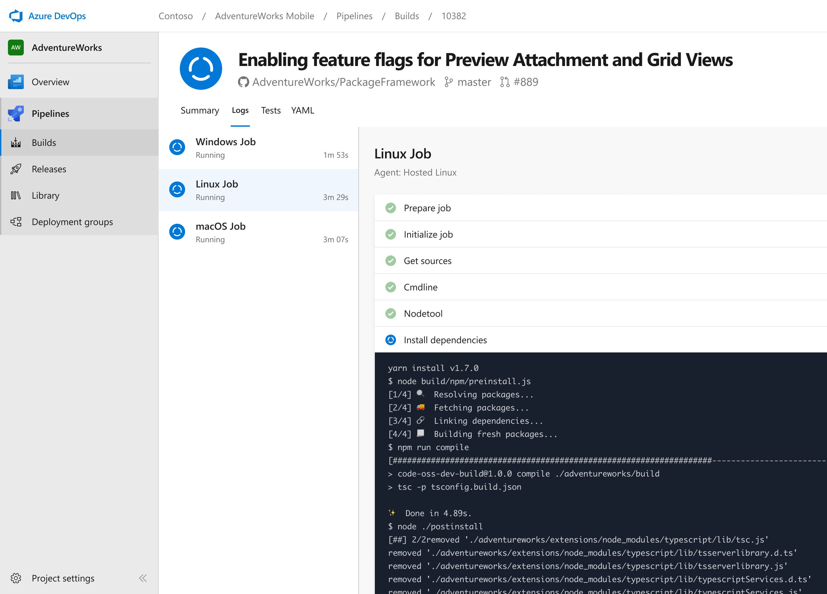




Azure DevOps Pipelines
Any language, any platform, any cloud
Build, test, and deploy Node.js, Python, Java, PHP, Ruby, C/C++, .NET, Android, and iOS apps. Run in parallel on Linux, macOS, and Windows. Deploy to Azure, AWS, GCP or on-premises
Extensible
Explore and implement a wide range of community-built build, test, and deployment tasks, along with hundreds of extensions from Slack to SonarCloud. Support for YAML, reporting and more
Containers and Kubernetes
Easily build and push images to container registries like Docker Hub and Azure Container Registry. Deploy containers to individual hosts or Kubernetes.
Best-in-class for open source
Ensure fast continuous integration/continuous delivery (CI/CD) pipelines for every open source project. Get unlimited build minutes for all open source projects with up to 10 free parallel jobs across Linux, macOS and Windows

Slide 23
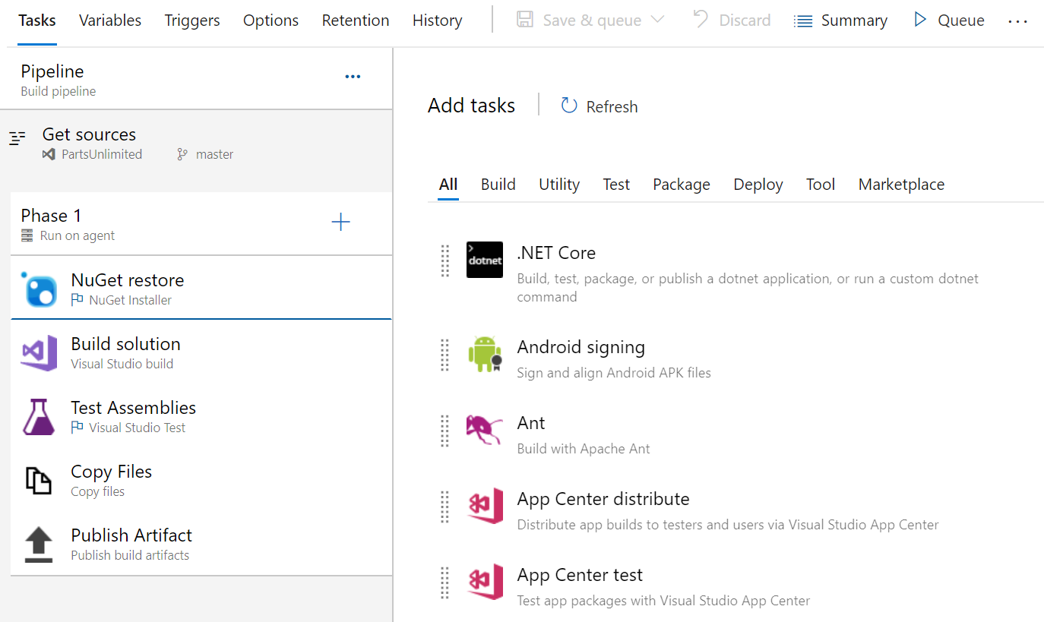
Azure DevOps Pipelines - GUI
Not part of your repository.
Cannot be versioned and shared across multiple users.
Simple drag and drop tasks for beginner’s
Lots of compatible and tested extensions.
Option to view YAML equivalent of GUI Pipeline

Slide 24
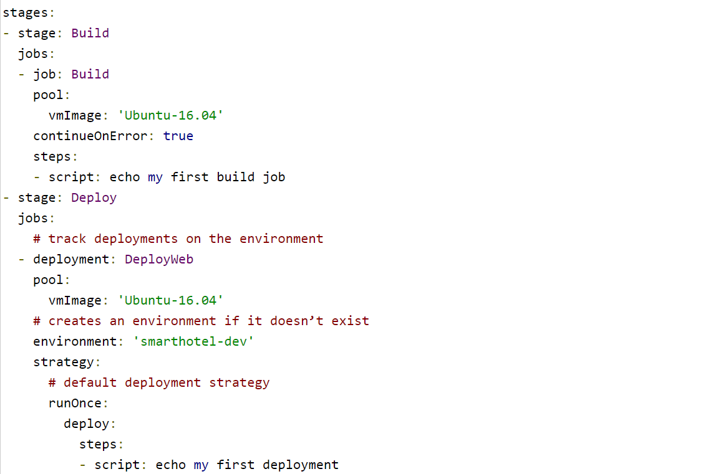
Azure DevOps Pipelines - YAML
We need to handle our pipelines versions
This model promotes reuse: templates
Add flow control to the pipeline, not to scripts
GUI is still there for end users and beginners
Also Validate if your extensions are YAML compatible

Slide 25
Building Azure DevOps Pipelines with YAML

Slide 26
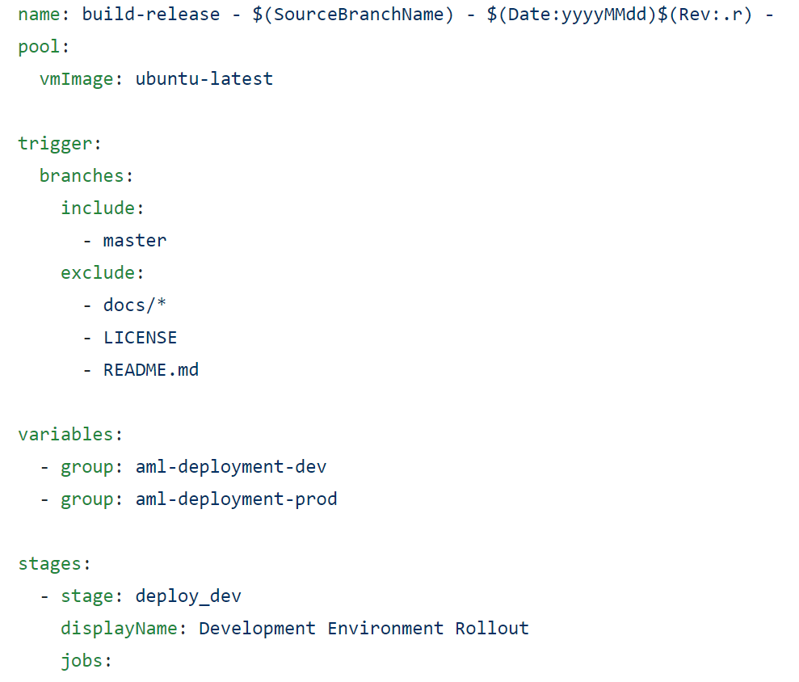
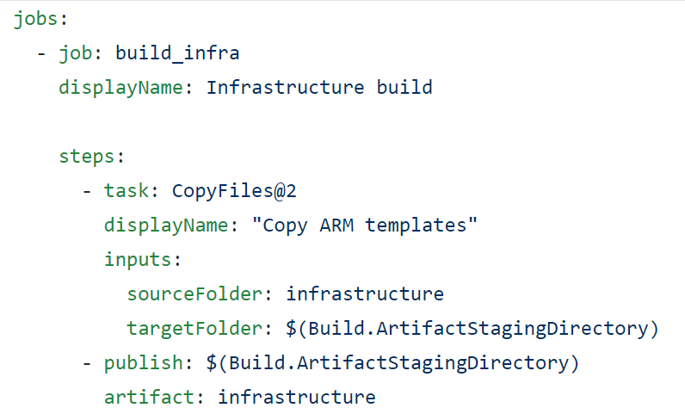
YAML Pipeline Structure
•Pipeline – one or more stages in a CI/CD process
•Stages – major divisions in a pipeline e.g. build app, run tests, deploy to production
•Jobs – linear sequence of steps
•Steps – tasks, scripts, template reference

Slide 27
Important Components to YAML Pipeline
Triggers
Agents
Environments
Pipeline triggers – execute a pipeline upon completion of another pipeline.
Scheduled triggers – execute pipeline at a specified time and frequency (uses cron syntax).
Pull request triggers – execute pipeline whenever a pull request is opened with a specified target branch.
Branches – execute pipeline whenever a commit is made to a specified branch (you have an option to exclude files or directories).
Microsoft-hosted agents – default option provided in with Azure DevOps where maintained and upgrades are taken care of and a fresh agent is used for each pipeline run.
Self-hosted agent – agent which is manually set-up and managed, dependencies will need to be installed manually but machine-level caching and configuration persist run to run which can boost speeds.
Collection of resources that can be targeted by deployments from a pipeline e.g. Dev, Test, QA, Staging, Production, etc.
Can allow things like:
Displaying pipeline deployment history.
Viewing commits and work items to allow for traceability when verifying that code changes or feature or bug fixes have reached an environment.
Validate if an application is functioning at a desired state.
Add permissions to secure environments by specifying the users / pipelines which can be associated with an environment.

Slide 28
Important Components to YAML Pipeline
Approvals and Gates
Variable Groups
Service Connections
Give you control over the start and completion of deployment pipelines.
Pre-specified number of approvers must manually accept or reject deployments to progress to the next stage / job in the pipeline.
Can be configured to pause the pipeline and prompt users to carry out manual tasks than resume / reject the deployment.
Store values that should be controlled and made available across pipelines.
Can be used to store secrets.
Can be configured to restrict use to specified pipelines.
Used to connect to external and remote services to execute tasks in a job.
Common service connection types:
Azure Resource Manager - defines and secures a connection to an Azure subscription using a Service Principal or a Managed Service Identity
GitHub / GitHub Enterprise Server - defines a connection to a GitHub repository.
External Git - defines and secures a connection to a Git repository server.
Docker Registry - defines a connection to a container registry.

Slide 29
Demo: IaC Deployment Across Enviroments

Slide 30
Resources

Slide 31
Resources
Pipeline Schema: https://docs.microsoft.com/en-us/azure/devops/pipelines/yaml-schema
CI Triggers (GitHub): https://docs.microsoft.com/en-us/azure/devops/pipelines/repos/github#ci-triggers
Agents: https://docs.microsoft.com/en-us/azure/devops/pipelines/agents/agents
Environments: https://docs.microsoft.com/en-us/azure/devops/pipelines/process/environments
Variable Groups: https://docs.microsoft.com/en-us/azure/devops/pipelines/library/variable-groups
Release Approvals and Gates: https://docs.microsoft.com/en-us/azure/devops/pipelines/release/approvals

